Slide 1
Children’s Parliament 2024
Purpose
An exciting opportunity for children to present their views to adults of influence and to see that they really can make a difference in a political way;
Engage young people in the democratic process;
Gain insight into the views of young people on key issues for the Council;
Encourage intra-school and inter-school debate;
Develop young people’s communication skills.

Slide 2
Children’s Parliament 2024
Format – Stage One
A relevant topic is agreed that young people’s input is relevant to and sought, led by the Council.
This year’s topic is:
Being the best place for children is really important to Torbay. What ideas do you have that would make a big difference to children? (see next slide for more information)
The topic is shared with all schools, along with an overview of the format;
Schools invite their Year 5 pupils to enter an in-school competition in teams of 4 where they present their views on the chosen topic, including highlighting any research that they have done on the issue raised;
Presentations are 5 minutes long and must be spoken presentations. Visual aids may be used, but PowerPoint and other presentation software / equipment is not allowed. This is to focus young people on the use of persuasive language and oral presentation skills;
Presentations take place in front of the school community and an official school election is held to identify the best presentation. Schools may wish to invite their ward councilors to the presentations and engage school council members as ‘ballot officials’;
The in-school ‘winners’ become the school’s elected representatives at the Children’s Parliament event.

Slide 3
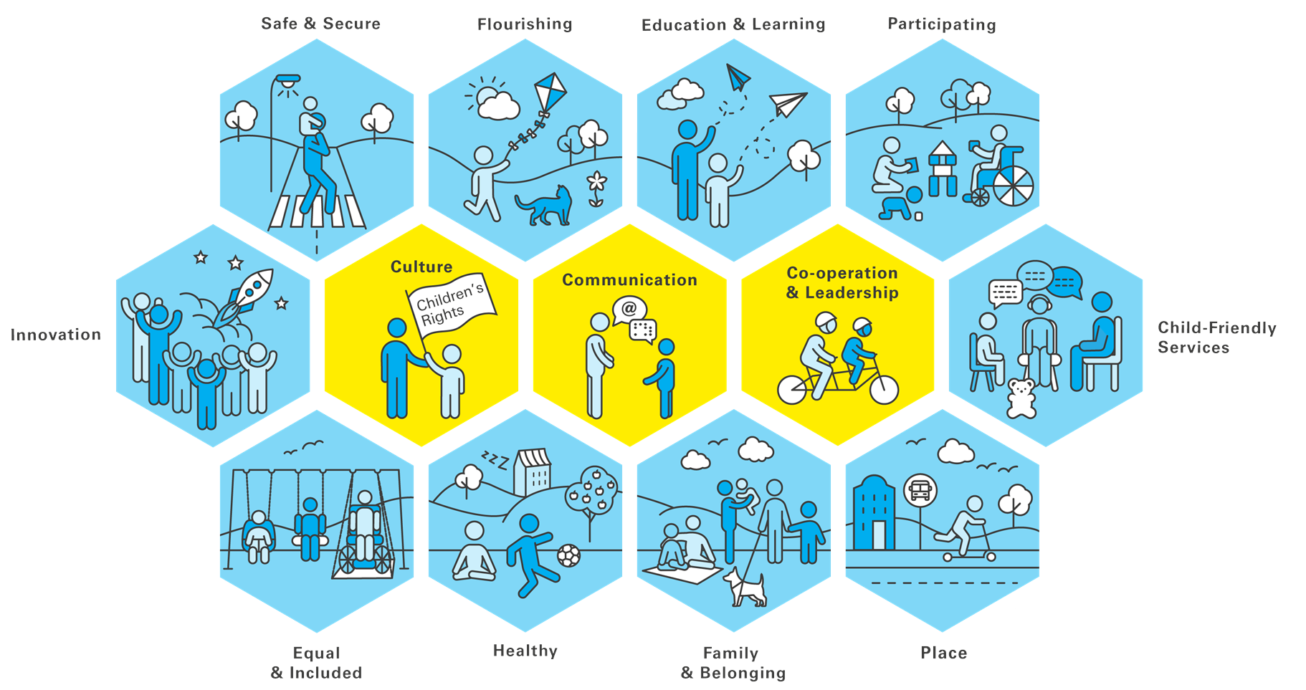

Children’s Parliament 2024
Theme
Being the best place for children is really important to Torbay. We are working hard to make changes for you. Working with UNICEF we are looking at how we can improve things within each of the topics within the blue badges (see image opposite). What ideas do you have that would make a big difference to children?

Slide 4
Children’s Parliament 2024
Format – Stage Two
All schools are invited to send their elected representatives to present to the Children’s Parliament, in The Banking Hall at the Town Hall on Friday 21st June, 10.00am – 2.00pm.
Each primary school has five minutes to present to the panel of judges, which includes council leaders, LA Education leaders and (hopefully) our local MP
All schools are given voting slips which are collated and form a single ‘schools’ vote’
Judges meet to decide on the most effective presentation
The winning team is awarded a prize of a visit to the Houses of Parliament, and a trophy for their school, as well as individual medals and an Amazon voucher (or similar). There may also be opportunity for the winning team to present at a cabinet meeting (tbc).

